Slide 1


Kannupriya Kalra
Scala Center

Slide 2
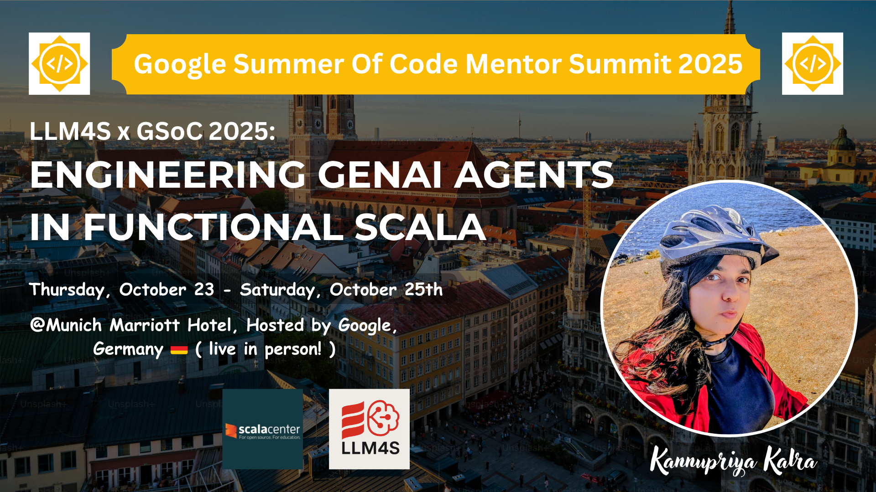

Slide 3

The Key Outcome: Traceability Unlocked
Tracing Support (PR #77, #119): Added execution flow tracking, spans, and timing. Integrated Langfuse for developer-friendly traces.
Type-Safe Tracing (PR #165): Rebuilt with sealed traits & composable backends. Ensured reliability and backward compatibility.
Demo & Multi-Backend (PR #184): Built a calculator agent for sequential tool-use. Showcased tracing with Console, Langfuse, and NoOp.
Shubham Vishwakarma
Total PRs Raised | PRs Closed / Merged | PRs Still Open
20 | 18 | 2

Slide 4
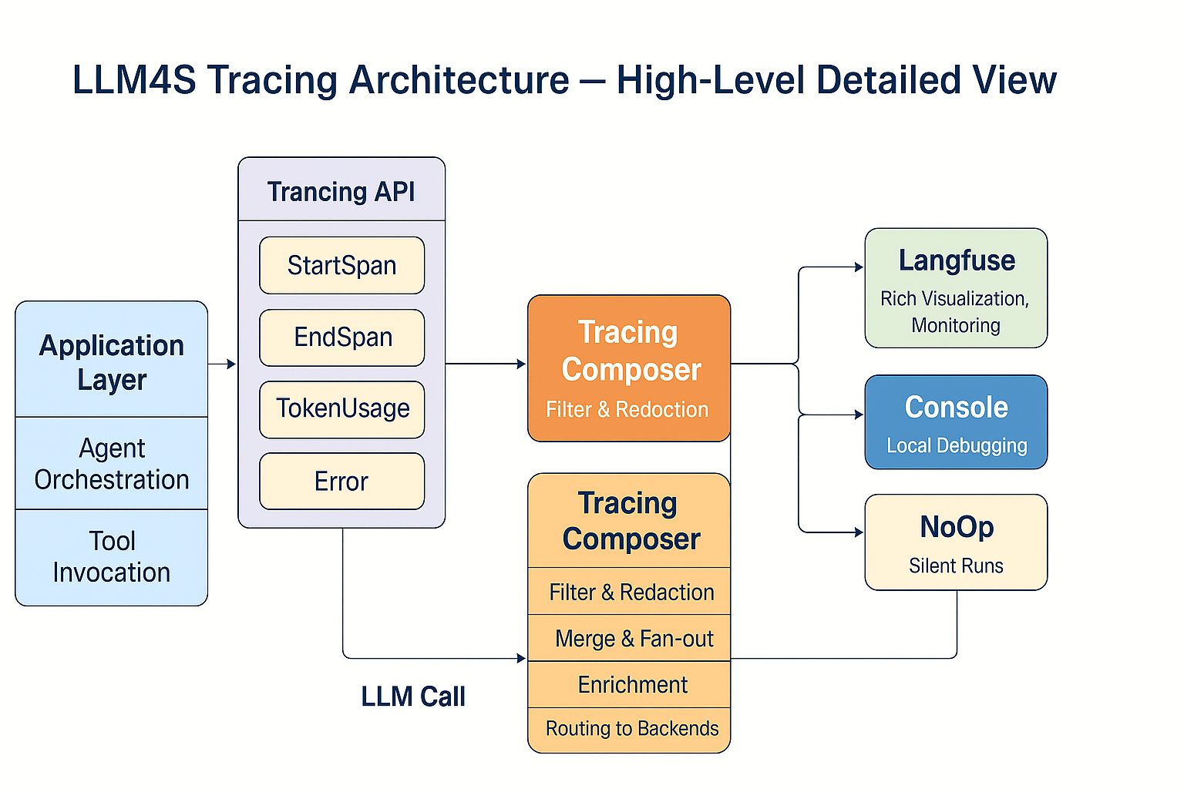
How It Works: The Architectural Clarity
LLM4S Tracing Architecture - High-Level Detailed View:
Diagram Flow: Application Layer (Agent Orchestration/Tool Invocation) → Tracing API (StartSpan, EndSpan, TokenUsage, Error) → Tracing Composer → Backends (Langfuse, Console, NoOp)
Tracing Composer functions: Filter & Redaction, Merge & Fan-out, Enrichment, Routing to Backends.

Slide 5

The Foundation for Future AI Systems
Beyond Tracing: The Next Chapter for LLM4S:
Multi-Agent Systems In Progress: DAG-based planner, Pub-sub signals, Scala-native, type-safe orchestration.
A Real Use Case: Meeting Minutes Generator Planned → Full traceability → every step tracked with spans/events.
LLM4S Project Link

